Slide 1
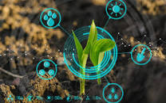


Crop Protection from Birds
Using Convolutional Neural Network
Made by- Chahat Tandon, Jaina H Shah ,
Ksheera P B ,Preethi R,Swathi R

Slide 2
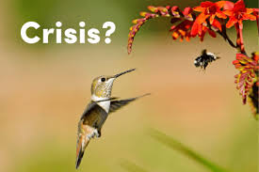
Existing
Problem
Crop damage due to animal intrusion is a critical problem faced by farmers in many parts of India, especially in areas near national parks and wildlife sanctuaries. It is not possible to manually monitor agricultural lands 24x7.
They can damage the plants by feeding on plant parts or simply by running over the field and trampling over the crops.
Therefore, wild animals may easily cause significant yield losses and provoke additional financial problems.

Slide 3
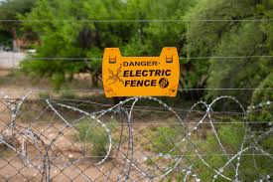
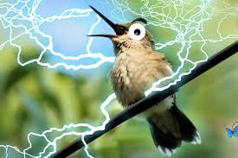
Our aim for the project is to make use of TensorFlow and Keras libraries from python and use deep learning application on the image classification to identify which bird is destroying your crops.
Currently, most farmers use wire fences or electric fences to prevent animals from entering the farmland. Electric fences hurt animals by inflicting shock and are a possible fire hazard so it's helpful to agriculture fields. We use CNN for this purpose.

Slide 4
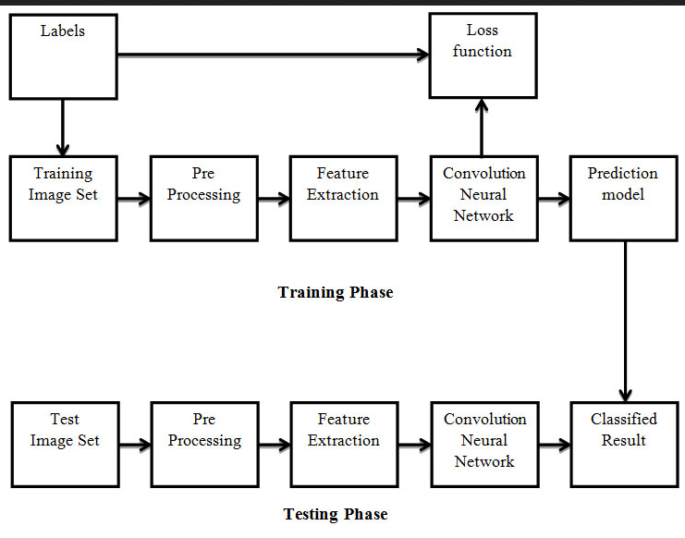
Block Diagram of our Training and Testing Phase

Slide 5
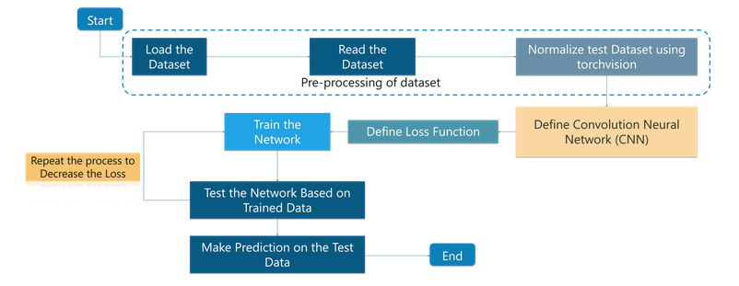
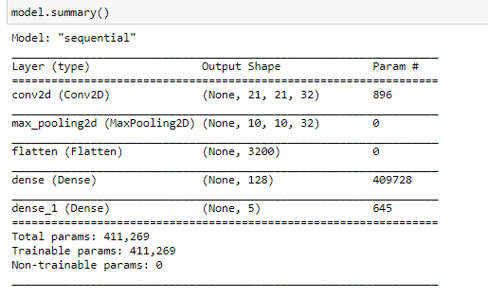
FLOWCHART
Summary of the layers used for the Deep learning model.

Slide 6
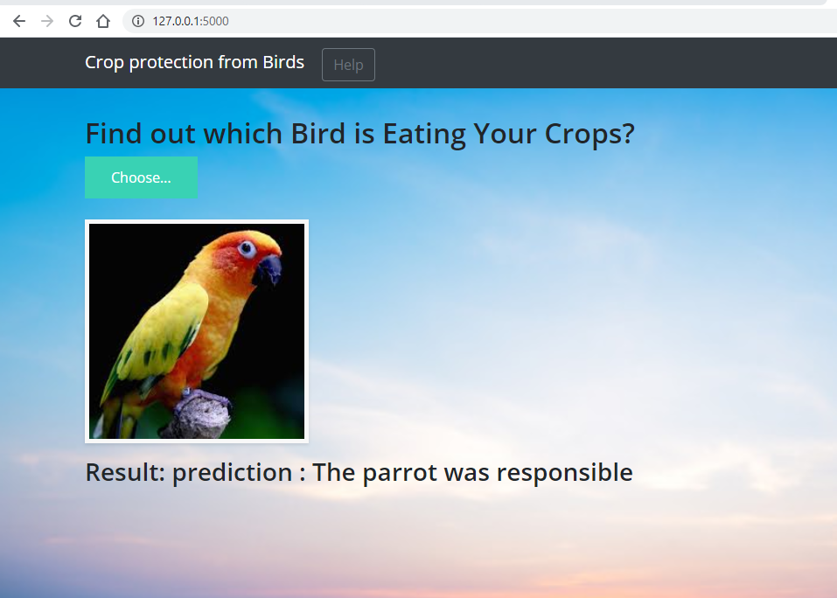
A snap of the model predicting birds!

Slide 7

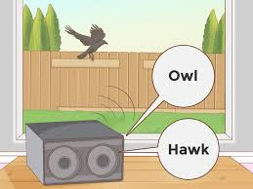
Conclusion:
Develop an Image classifier using convolutional neural networks.
The proposed system will monitor the entire crop at regular intervals through a camera which will be recording the surroundings throughout the day.
Once the frame matches our data then it will send information to the farmer and will produce an appropriate sound or alarm to the person who hands over that.
This ensures complete safety of crops from wildlife animals thus protecting the crops loss. Hence CNN is used to train the animal images.

Slide 8



Thus the crops will be saved and no birds will be harmed

